Slide 1

Text and Audio processing
By group
>MAHINDER (8133)
>MAYANK SINGH TOMAR(8137)
Project Guide
Prof. D.G.Auradhkar

Slide 2

Introduction
Today there is a wide spread talk about improvement of the human interface to the computer. Because no longer people want to sit and read data from the monitor. Since there is a painstaking effort to be taken, this involves strain to their eyes. In this aspect Speech Synthesis is becoming one of the most important steps towards improving the human interface to the computer.
Similarly audio interface allows humans to directly communicate to computer interfaces e.g. Google's search engine which allows the user to directly interact with the commands by speech.

Slide 3
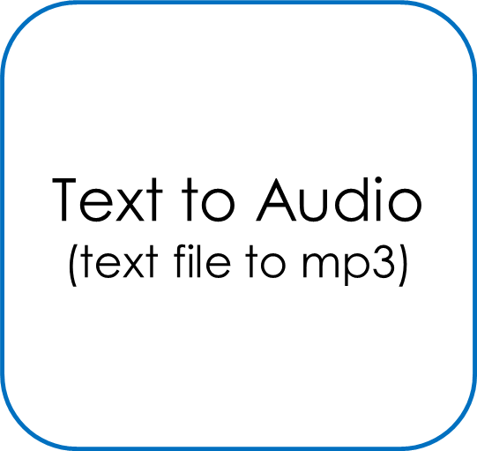
Proposed System
GUI application
Audio To Text
(Wav to text file)
Language Translator
(one to another language)

Slide 4
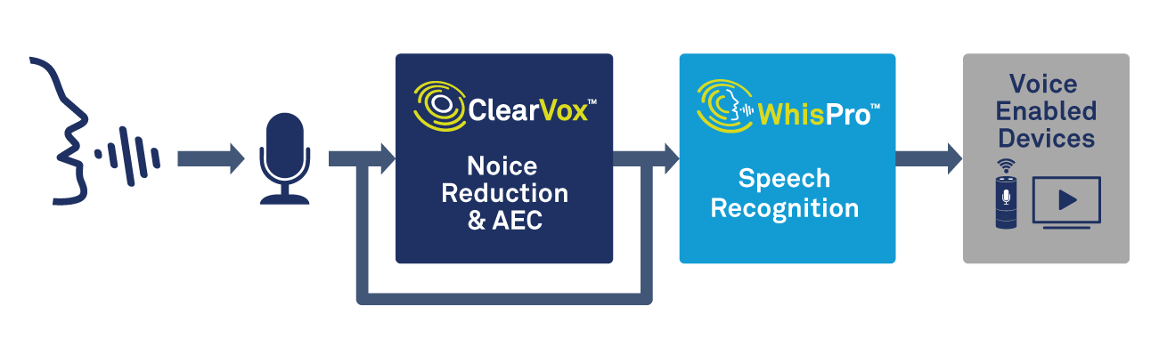


Speech-To-Text
Principal:
Speech Recognizer
Speech TEXT
(input) (Output)
Basic Flow Diagram Of Speech to Text System.

Slide 5
Components Of Speech Recognition System:
Speech Capture Device
DSP Module
Preprocessed Signal Storage
Pattern-Matching Algorithm
Recognized
Words or Alternatives
Reference Speech
Patterns

Slide 6
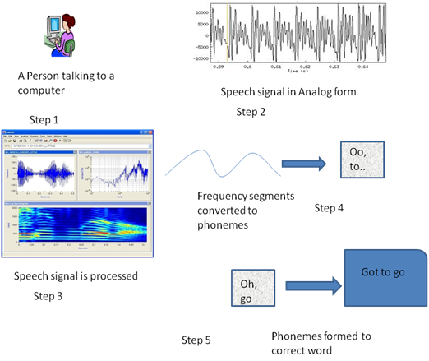


Working Of Speech Recognition System:
Step 1
Step 2
Step 3
Sentences formed using Language Models
Step 6
Step 5
Step 4
Language models: A language model takes the words and ties them together to make sentences, i.e. it predicts the most likely sequence of words (or text strings) among several a set of text strings.

Slide 7
Audio input: Dolphins swim fast
For D:
dol
doll
Consider,
dol
dol
or
doll
t
th
d
d
Back to previous step and select other options
dol + phins
dol + fins
Similarly for
fins
or
phins
doll is meaningfully correct
But
doll + fins
doll + phins
both incorrect
d o
Satistically most probable
phins
swim
+
+
It follows similar steps for word swim
for spoken word fast:
fast
is grammatically
correct with rest of the word formation
fast
fast
or
passed
Combination of all the steps gives the final text output as:
=
Dolphins swim fast

Slide 8
The Speech Recognition System depends on the following Factors:-
Isolated Words: There needs to be a pause between the consecutive words spoken because continuous words can overlap making it difficult for the system to understand when a word starts or ends. Thus there needs to be a silence between consecutive words.
Single Speaker: Many speakers trying to give speech input at the same time can cause overlapping of the signals and interruptions. Most of the speech recognition systems used are speaker dependant systems.
Vocabulary size: Languages with large vocabulary are difficult to be considered for pattern matching than those with small vocabulary as chances of having ambiguous words are lesser in the latter.

Slide 9
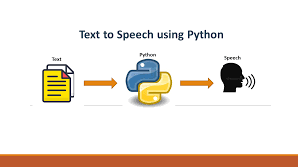
Text-To-Speech
Our TTS System uses python modules Pyttsx3 & gTTS,
able to convert any inputted text
& text file to voice output.

Slide 10
Working Flow of TTS System
Text-To-Speech Conversion
Natural Language Processing
Text Processing,
Linguistic Analysis
Digital Signal Processing
Mathematical modules, Algorithms,
Computations
Text
Normalized
Phonemes
Speech
Text
Prosody

Slide 11
What’s Text Normalization?
Raw Text Normalized Text
(containing Symbols, Abbreviations) (Word/ written Text Format )
Raw Text | Normalized Text
DR. | Doctor
MR. | Mister
900 | Nine zero zero
Rs. 80 | Rupees Eighty

Slide 12
Natural Language Processing: G to P Conversion
Grapheme To Phoneme Conversion:
Graphemes Phonemes
(written text of words, etc.) (Pronunciation of each word)
For Example:
Word | Pronunciation
SPEECH | S P IY CH
RECOGNITION | R EH K IH G N IH SH AH N
BAYES | B E Y Z

Slide 13

NLP: Prosody Analysis
Prosody determines the
naturalness of TTS System.
Intonation Modelling
Amplitude Modelling
Prosody Generating Factors
Sound Intensity
Duration Modeling

Slide 14

Digital Signal Processing: Speech Synthesis
Speech synthesis is the artificial production of human speech. A synthesizer can incorporate the model of vocal tract & other human voice characteristics to create a completely “Synthetic” output.
HMM (Hidden Markov Model ) based speech synthesis technique is used here. This process works in 2 parts as,
Training phase
Synthesis phase
Digital Signal Processing
Synthesis Techniques, Algorithms
Symbolic linguistic Representation
(phonemes, prosody)

Slide 15
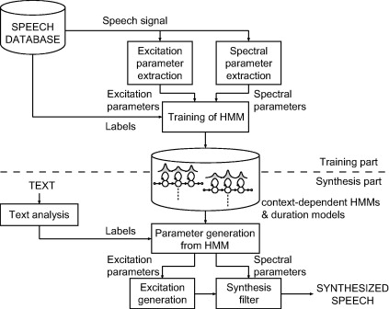
HMM based Speech Synthesis: Architecture

Slide 16
Language Translator
How does Normal Translation work?
English Sentences
French Translation
How old are you?
Comment vieux sont vous?
How Comment
Old Vieux
Are Sont
You Vous

Slide 17
So how does translation work?
English Input
French Output
What is your name?
Neural Network
Quel est ton nom?

Slide 18
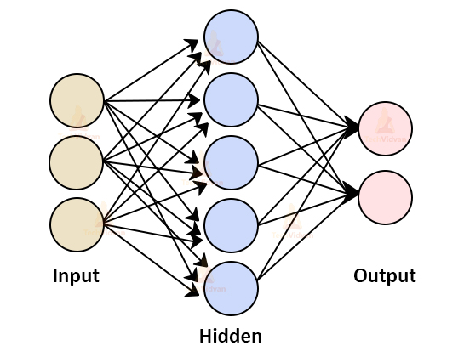
What are Neural Networks?

Slide 19

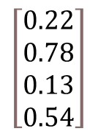
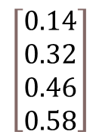
Architecture of Neural Network
LSTM Encoder
$$\left[\begin{aligned}&0.14 \\ &0.32 \\ &0.46 \\ &0.58\end{aligned}\right]$$
Attention Mechanism
$$\left[\begin{aligned}&0.22 \\ &0.78 \\ &0.13 \\ &0.54\end{aligned}\right]$$
LSTM Decoder
Vector-to-sequence
Sequence-to-vector
What is your name?
Quel est ton nom?
Encoder-Decoder Architecture

Slide 20
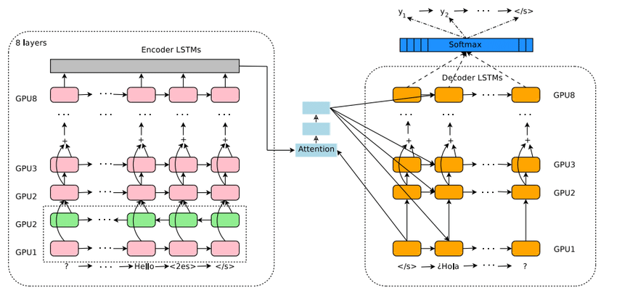
How Does Google Trans API work?

Slide 21
Referrences:
1) https://nptel.ac.in/courses/117/105/117105145/ : Nptel Course about Digital Signal Processing by IIT Kharagpur(prof. SK Das Mandal)
2) https://core.ac.uk/download/pdf/83592918.pdf : Design and Implementation of Text To Speech Conversion for Visually Impaired People By Covenant University(USA)
3) https://www.irjet.net/archives/V7/i5/IRJET-V7I5854.pdf : A REVIEW ON METHODS FOR SPEECH-TO-TEXT AND TEXT-TO-SPEECH
CONVERSION By Inderprastha Engineering College, Ghaziabad(UP)
4) https://nptel.ac.in/courses/106/106/106106211/# : Nptel Course about Applied NLP by IIT Madras (Prof. Ramaseshan Ramchandran)
5) https://freevideolectures.com/course/4193/nptel-multimodal-interaction/1 : Course about Multimodal interaction by IIT Madras (Prof. Dr.-Ing.Sebastian Moller)
6) https://youtu.be/iNbOOgXjnzE : Video about how speech recognition works By Sam Stork
7) https://iopscience.iop.org/ : Evaluation methodology for Speech To Text Services similarity and speed characteristics focused on small size computers By J.E. Aguilar-Chacon and D.A. Segura-Torres

Slide 22
8) http://ijarcet.org/ : A REVIEW ON SPEECH TO TEXT CONVERSION METHODS By Miss.Prachi Khilari and Prof. Bhope V. P.
9) https://www.youtube.com/watch?v=U0XtE4_QLXI : Video about A Basic Introduction to Speech Recognition (Hidden Markov Model & Neural Networks) By Hannes van Lier
10) https://blogs.commons.georgetown.edu/cctp-607-spring2019/2019/05/01/the-ai-powers-behind-google-translate/ : The AI Powers Behind Google Translate By Tianyi Zhao
11) https://blogs.commons.georgetown.edu/cctp-607-spring2019/2019/05/01/the-ai-powers-behind-google-translate/

Slide 23
!!!Thank You!!!

